Slide 1
POST IT
By-
RUSHIKESH KARAD
CHINMAY SARAF
SIDDHARTH SABADRA

Slide 2
OBJECTIVE -
TO CONNECT PEOPLE
TO EXPRESS YOUR VIEWS
SOCIAL AWARENESS

Slide 3
SWOT-
STRENGTH
1. Large market reach or penetration
2. Very useful if you are setting up a digital engagement strategy (young people)
3. It is real-time
WEAKNESS
1. Can’t create groups
2. Chatting is not included
3. Lagging app due to high quality of images

Slide 4
SWOT-
OPPORTUNITIES
1. Promotions, news, events that can be offered through social media platforms
2. Post filtering
THREATS
1. To Sustain in competitive environment
2. Security breaches
3. Spam posts
Ha

Slide 5
TECHNOLOGIES USED-
FIREBASE DATABASE USED
PICASSO
CIRCULAR IMAGE VIEW
CARVIEW/RECYCLAR VIEW
SUPERNOVA IMAGE EMOJI LIBRARY
NIFTYDIALOGEFFECTS
IMAGE CROPPER

Slide 6
UI FEATURES-
MINIMALISTIC UI
SIMPLE AND SLICK

Slide 7


Slide 8
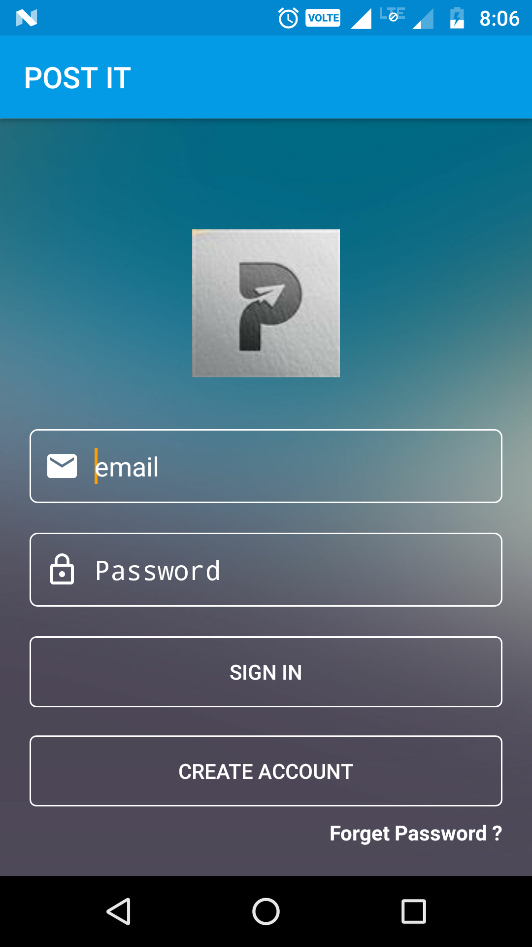
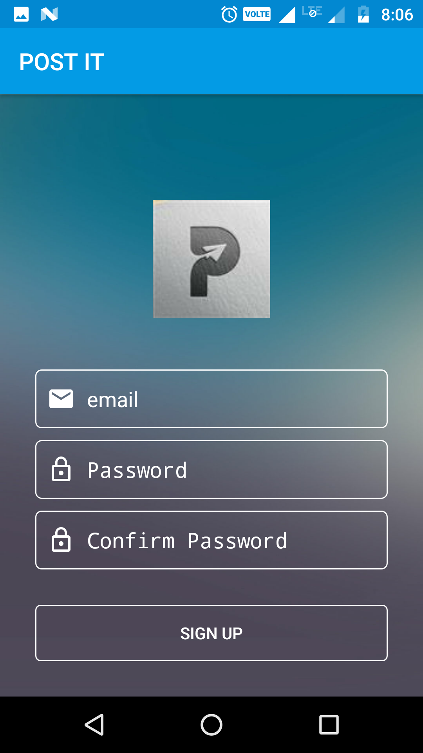

Slide 9
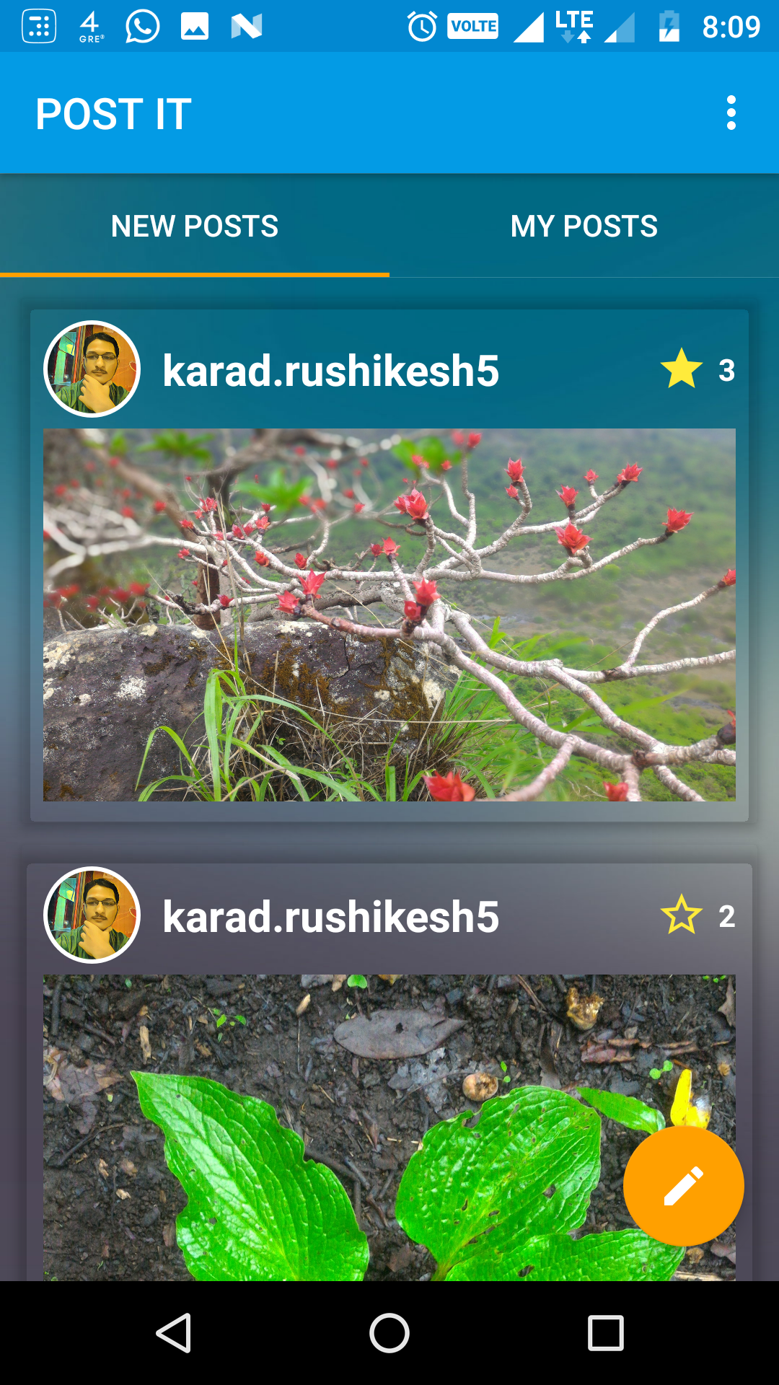
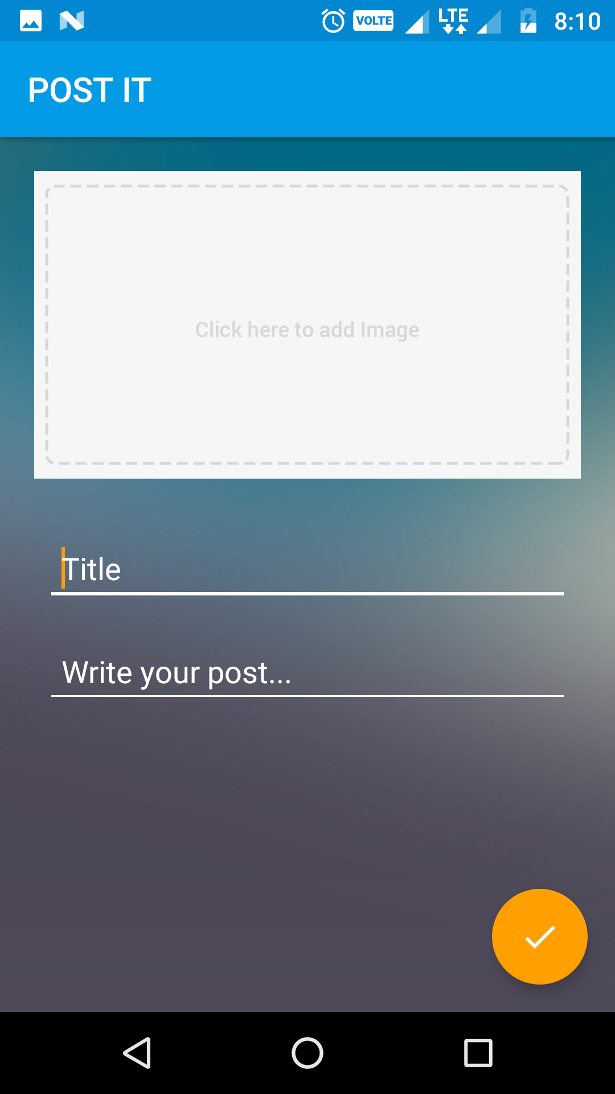

Slide 10
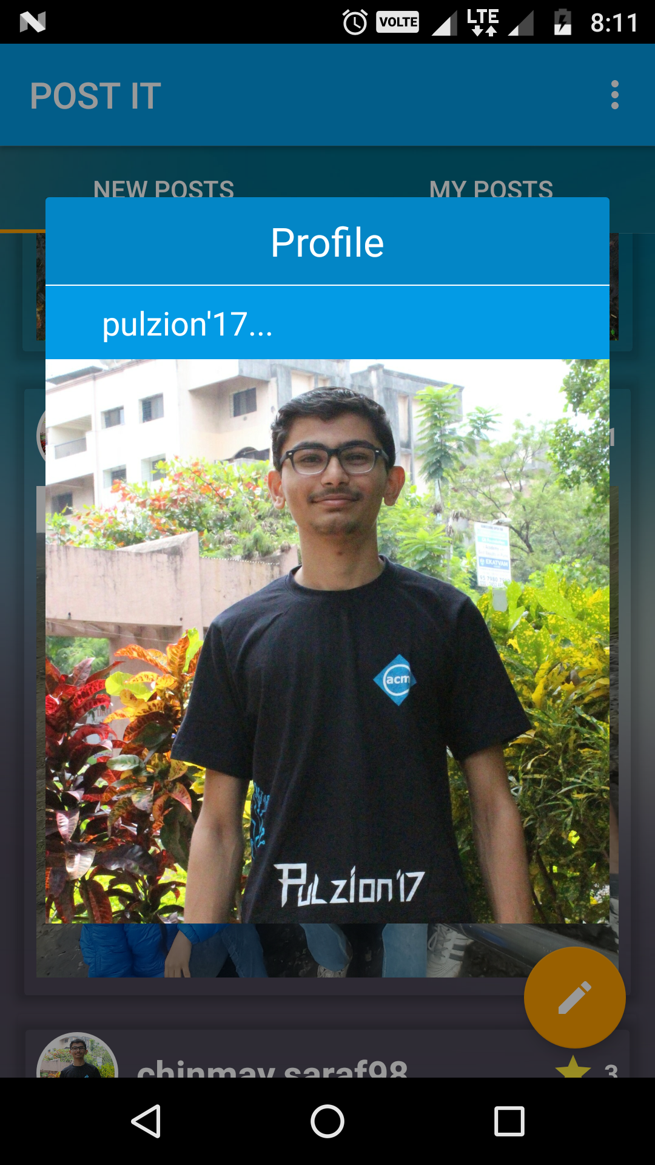
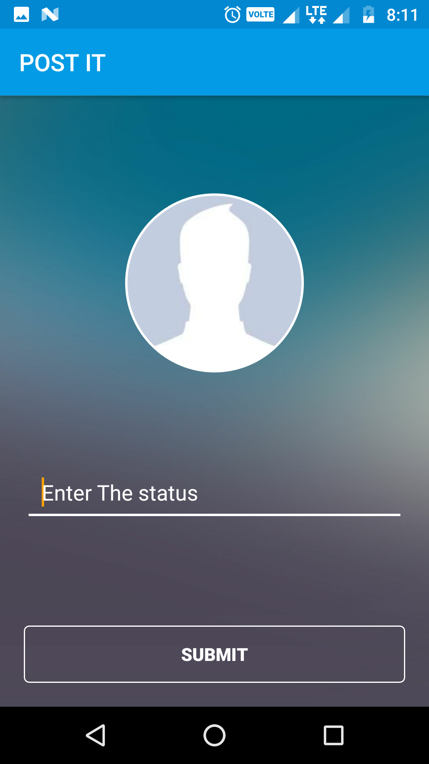

Slide 11
WHY POST IT?
BEST PHOTO QUALITY
PLEASANT UI
USER FRIENDLY
PHOTO EDITING

Slide 12
CONCUSION-
SOCIAL NETWORKING PROVIDES A POWERFUL PLATFORM TO MAKE AN INTERACTION BETWEEN PEOPLE

